Slide 1
R
SQL - Database
Sqldf ,
MySql(RODBC), MYSQL(RMySQL)

Slide 2
SQL is a database query language - a language designed specifically for interacting with a database.
extracting data, updating data, replacing data, creating data,

Slide 3
Famous database
SQLite,
Microsoft SQL Server,
PostgreSQL
MySQL
Oracle
HANA
DB2

Slide 4
mongoDB
No SQL

Slide 5
Main types
SQL with in R Databases / R Data tables
SQL from RDBMS Like Oracle/sql server/mysql

Slide 6
sqldf
install.packages("sqldf")
# connection, I will discuss later
sqldf('SELECT age, circumference FROM Orange WHERE Tree = 1 ORDER BY circumference ASC‘)
Select * from Orange
5 – Tress data

Slide 7
sqldf("select * from iris")
Available tables
BOD , iris,mtcars
-Dbname – case sensitive !!

Slide 8
iris1 <- sqldf('SELECT Petal.Width FROM iris')
iris2 <- sqldf('SELECT "Petal.Width" FROM iris')
SELECT * FROM iris LIMIT 5‘
Order by
Group by

Slide 9
Where
Where in, where like
AND
OR
Average
Count
Sum

Slide 10
R and mysql
RMySQL is a database interface and MySQL driver for R
library(DBI)
Install.packages("RMySQL")
install.packages("devtools")

Slide 11
On phpmyadmin ( mysql in XAMPP)
CREATE DATABASE dataCricket;
Create table – Players
CREATE TABLE `datacricket`.`players` ( `id` INT NOT NULL , `Name` VARCHAR(50) NOTNULL , `Age` INT NOT NULL , `runs` INT NOT NULL ) ENGINE = InnoDB;

Slide 12
INSERT INTO `players` (`id`, `Name`, `Age`, `runs`) VALUES ('1', 'Sachin', '44', '12000'), ('2', 'Dhoni', '36', '8000');

Slide 13
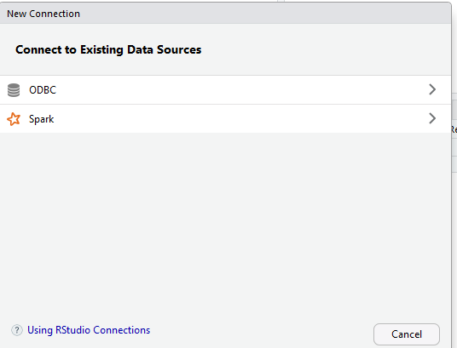
ODBC – Update with lib

Slide 14
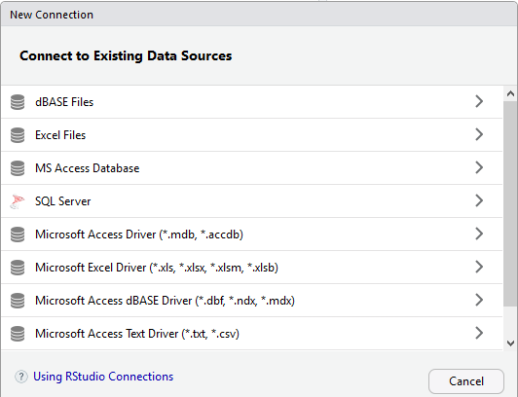
install.packages("odbc")

Slide 15
RMySQL
RODBC
install.packages("RODBC")

Slide 16
library(DBI)
library(RMySQL)
mydb <- dbConnect(MySQL(), user='root',password="",dbname="datacricket", host='localhost')
dbListTables(mydb)

Slide 17
dbListFields(mydb, 'players')
# “players” is a “table name” in our db
rs = dbSendQuery(mydb, "select * from players")
rs = fetch(rs,n=-1)
rs

Slide 18
https://cran.r-project.org/web/packages/RMySQL/RMySQL.pdf

Slide 19
library(DBI)
library(RMySQL)
mydb <- dbConnect(MySQL(), user='root',password="",dbname="datacricket", host='localhost')
dbListTables(mydb)
dbListFields(mydb, 'players')
rs = dbSendQuery(mydb, "select * from players")
rs = fetch(rs,n=-1)
print(rs)

Slide 20
dbSendQuery(mydb, "USE bookstore")
fetch(dbSendQuery(

Slide 21
Odbc connector download
vs 2015 redistributable download

Slide 22
RODBC
library(RODBC)
channel <- odbcConnect("mysql", uid="root", pwd="")
p <- sqlQuery(channel, "SELECT * FROM datacricket.players")
p
#Note . We have to set ODBC data source properly.
ODBC connection: For Windows only

Slide 23
> odbcDataSources()
dBASE Files
"Microsoft Access dBASE Driver (*.dbf, *.ndx, *.mdx)"
Excel Files
"Microsoft Excel Driver (*.xls, *.xlsx, *.xlsm, *.xlsb)"
MS Access Database
"Microsoft Access Driver (*.mdb, *.accdb)"
mysql
"MySQL ODBC 8.0 Unicode Driver"

Slide 24
Gdata for Excel _ Perl dependent !!
install.packages("XLConnect")

Slide 25
Mongodb
require(RMongo) mongo <- mongoDbConnect('kenblog', 'localhost', 27017)
# this requires sepate and more knowledge.

